Slide 1


Industry Sector Partnerships, & The Central Ohio Manufacturing Partnership (COMP)
The information contained herein is based on contributions from the founding members of COMP, and the work-product of Sara Tracey, Ph.D., Senior Specialist, Career Pathways, Thomas P. Miller and Associates, and the Ohio Manufacturers’ Association website.

Slide 2
Industry Sector Partnerships
Central Ohio Manufacturing Partnership (COMP)
Manufacturing Sector Partnerships’ Successes in Ohio
Replicating Success & COMP’s Path Forward
Q&A

Slide 3
Industry Sector Partnerships

Slide 4
“The Why” of Manufacturing Partnerships
Manufacturing in Ohio is the largest economic sector with $112.24B in GDP in 2018, and it accounts for 16.6% of Ohio’s GDP trailing only the states of California and Texas.
From 2013 through 2017, 51% of all new site selections in Ohio were for manufacturing projects.
According to the National Association of Manufacturers:
  If you considered the U.S. manufacturing sector as a separate economy at $2.18 trillion it would be the eighth largest economy in the world.
  In 2016, there were 249,962 firms in the manufacturing sector.
    Only 1.5% of the total employed more than 500 associates.
    75 % of the manufacturers employed 20 or less associates.
  “Over the next decade, 4.6 million manufacturing jobs will likely be needed, and 2.4 million are expected to go unfilled due to the skills gap. Moreover, according to a recent report, the lack of qualified talent could take a significant bite out of economic growth, potentially costing as much as $454 billion from manufacturing GDP in 2028 alone. Between now and 2028, a persistent skills shortage could cost $2.5 trillion in reduced output.” (Source: Deloitte and The Manufacturing Institute)
Notes:
1) Minimum investment of $1,000,000, 2) 20,000 SF or more, and 3) job creation of 20 or more (50 or more prior to 2014)

Slide 5
Industry Sector Partnerships
The Ohio Manufacturers’ Association (OMA) supports the Industry Sector Partnership model to improve the effectiveness of manufacturing organizations throughout the state of Ohio.
An Industry Sector Partnership is:
Led by Employers: to ensure the system is truly demand-driven and will lead to better outcomes for individuals.
Focused on a single industry: to allow employers to connect with peers from their own industry, identify needs beyond basic workplace skills, and dive deeply into the technical needs of the industry.
Regional: to address unique needs of subsectors while reflecting the true dynamics within a regional economy.
Convened by a neutral intermediary: to align all relevant partner programs and resources as solutions to identified industry needs.
Sector partnerships are a proven workforce development strategy that promote collaboration among manufacturers, educational institutions and community resource organizations.

Slide 6
The Four Priorities of the OMA’s Workforce Policy
As a result of surveys and other feedback from the initial OMA Manufacturers Workforce Summit in November 2017 these four priorities have shaped the OMA’s Workforce policy:
Leadership / Sector Partnership Capacity Building: Through technical assistance and best practices sharing, increase industry champions’ and partnerships’ abilities to drive systems change.
Policy Development: Amplify the voice of manufacturers with lawmakers and public officials.
Marketing and Communication: Leverage the Making Ohio brand to elevate awareness and interest in manufacturing careers.
Education Innovation: Increase public/private collaborations that train and educate the manufacturing workforce of tomorrow.

Slide 7
Manufacturing Partnerships Four Themes
Within each of the previously mentioned four priorities, the OMA organizes activities around these themes:
Industry-Recognized Credentials (and Industry-Recognized Apprenticeship): Expand awareness and attainment of industry-recognized credentials by educating manufacturers, intermediaries, and education providers on the value of credentials; advocate for policies that award credit for credentials; and align earn-and-learn programs with credentials.
Career Pathways: Adopt statewide pathways to ensure that programs and initiatives are aligned with industry demand and offer predictable transitions for students.
Partner Engagement: Support industry champions and emerging sector partnerships as they ensure workforce, economic development, and education systems are fully engaged in sector partnership strategy.
Fund Development and Sustainability: Expand outreach to sponsors and philanthropic funders; build regional sector partnerships’ ability to secure their own funding.

Slide 8
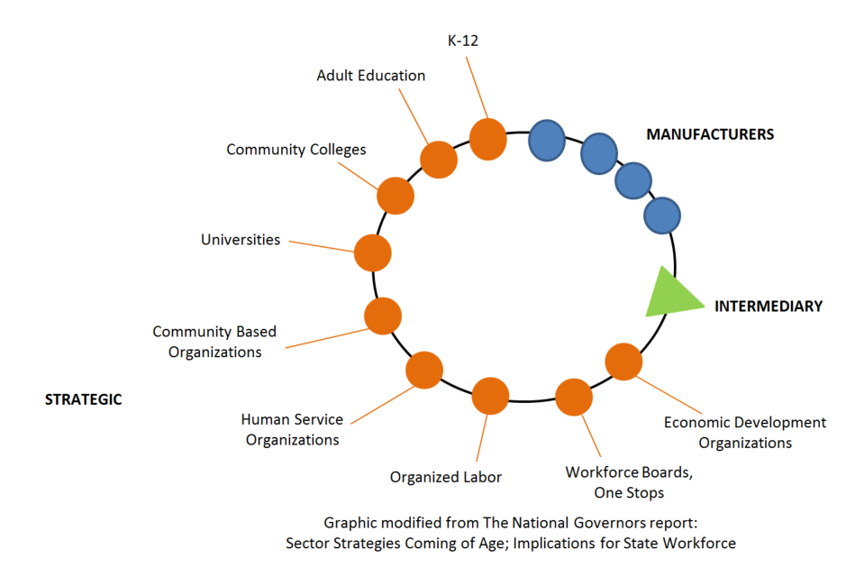
The Industry Sector Partnership Model

Slide 9
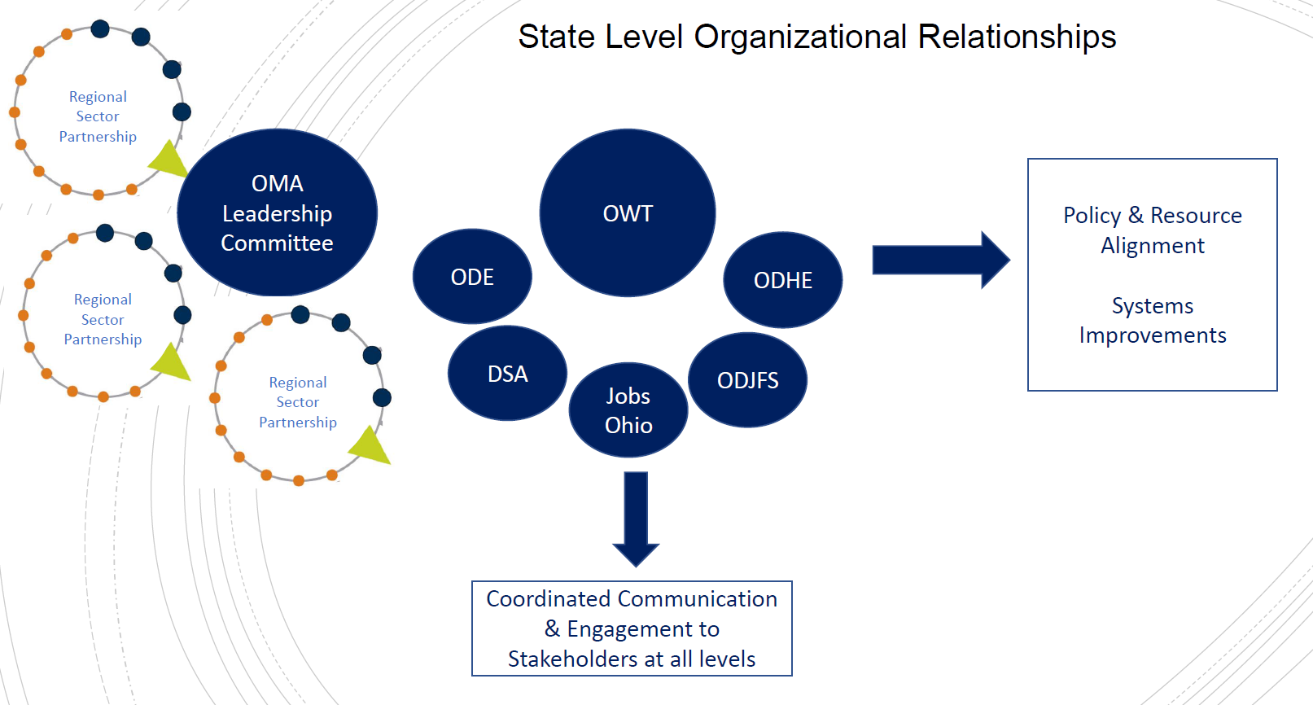
State Level Organizational Relationships
Members of each Regional Sector Partnership participate on the OMA Leadership Committee which serves as a communication bridge between the sector partnerships and these state agencies that are pivotal to successfully developing the future talent pipeline for manufacturing.

Slide 10
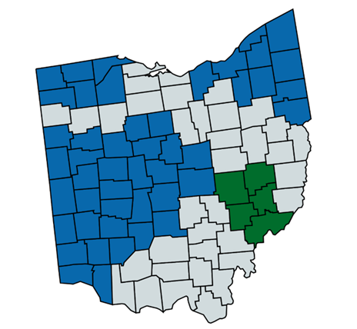

Industry Sector Partnerships In Ohio
Central:
  Central Ohio Manufacturing Partnership
  North Central Ohio Region Industry Manufacturers Workforce Alliance
Northeast:
  Alliance for Working Together Foundation
  ConxusNEO
  Cuyahoga County Manufacturing Sector Partnership
  Lorain County Manufacturing Council
  Mahoning Valley Manufacturers’ Coalition
Northwest:
  Northwest Ohio Manufacturing Alliance
Southeast:
  Appalachian Ohio Manufacturers Partnership (Unofficial)
Southwest:
  Advanced Manufacturing Industry Partnership
  Dayton Region Manufacturing Workforce Partnership
West:
  West Central Ohio Manufacturing Partnership
  This list is based on responses to the 2018 OMA Intermediary Survey Results

Slide 11
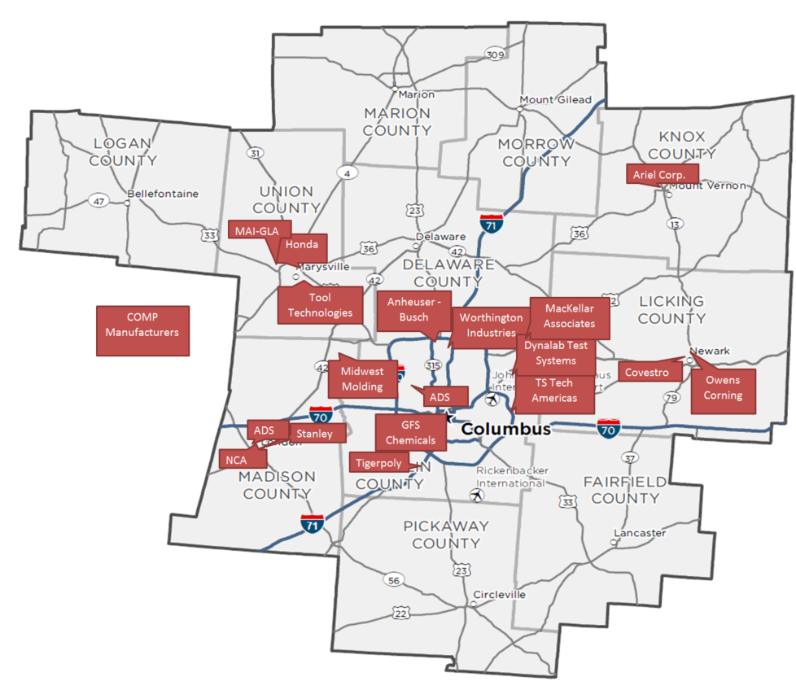
COMP Manufacturing Members
COMP covers an 11-county region that includes: Delaware Fairfield
Franklin
Knox
Licking
Logan
Madison
Marion
Morrow
Pickaway
Union
This area includes 1,700 manufacturers employing over 86,000 people.

Slide 12
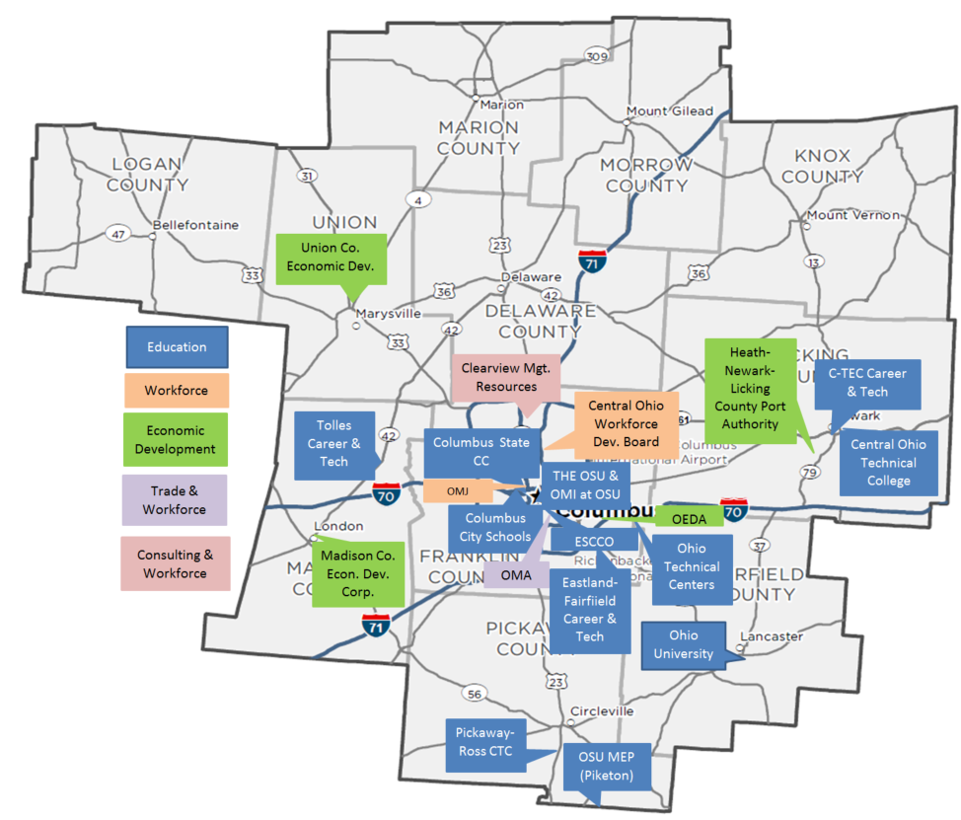
COMP Education, Workforce, Economic Development, Trade & Workforce, and Consulting & Workforce Members

Slide 13































Slide 14
The Founding of COMP
In August 2017, representatives from the initial founding companies of what would eventually become COMP met at the OMA headquarters in Columbus to discuss shared challenges and the need for a public-private partnership to create mutually beneficial solutions.
The consensus among all of the participants was:
there is a continuing shortage of qualified job applicants for manufacturing positions in central Ohio
this situation is not new and they see no resolution on a going forward basis
as single entities most manufacturers do not have the financial resources, staff, or time to adequately train and fill their open positions as urgently as they need them
4) there doesn’t appear to be any active external initiatives to develop a comprehensive, holistic, and sustainable long-term solution to manufacturing’s skilled labor issue.

Slide 15
Mission, Vision, & Structure
The mission of COMP is “To create a connected system to source manufacturers with qualified talent.”
The vision for the organization is equated with what success looks like in 2020: Having established alliances with identified groups engaged and at the table in partnership, increasing the number of qualified applicants available to manufacturers in the central-Ohio region.
COMP was incorporated on September 3, 2019 and is a 501(c)(3) non-profit organization.

Slide 16
How COMP Can Support Educators and Students
The manufacturers can support the schools in the region by:
  Actively participating on Business Advisory Councils.
  Speaking to potential students and their parents about careers in manufacturing and the available training at the technical centers either on a one-on-one level, job fair, or during a career night.
  Hosting educational plant tours (Manufacturing Day, or at any time there is an interest).
  Supporting existing programs with manufacturers’ incumbent workers where applicable.
  Providing resources and assisting the collaborative development of new courses or programs.

Slide 17
Manufacturing Sector Partnerships’ Successes In Ohio
The success of the manufacturing partnerships will ultimately be measured by their ability to work with all of their stakeholders to reinforce, populate, and sustain existing educational programs, and to jointly innovate new programs that will meet the hiring needs of manufacturers both today and well into the future.

Slide 18
Scaling Apprenticeships Through
Sector Based Strategies
Overview:
The Ohio Manufacturing Workforce Partnership (OMWP) was awarded a $12,000,000 grant by the US Department of Labor’s (USDOL) Scaling Apprenticeships through Sector-Based Strategies program.
Lorain County Community College was the lead applicant while the Ohio Manufacturers Association served as the co-lead applicant with primary responsibilities for engaging businesses by drawing on its 1,400+ members and coordinating a network of 12 regional sector partnerships with potential to engage 5,000+ Ohio manufacturing businesses in total.
Expected Outcomes:
Adoption and expansion of Apprenticeship pathways through sector partnerships.
Engage 500+ employers
Implement 25 new and 45 expanded apprenticeship programs for the
targeted occupations (Production, Machining, Welding, Industrial
Maintenance, Industry 4.0)
Enroll 5,000 apprentices between July 15, 2019 and July 14, 2023

Slide 19
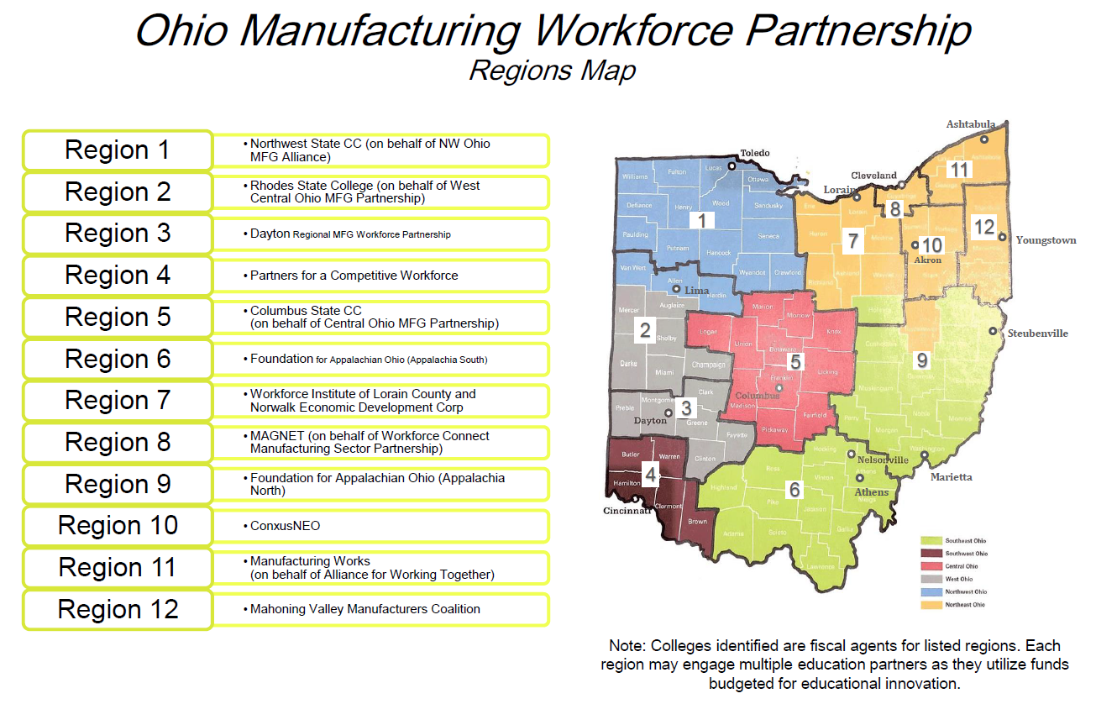
Scaling Apprenticeships Through
Sector Based Strategies

Slide 20
Scaling Apprenticeships Through
Sector Based Strategies & COMP
Required Components of OMWP Apprenticeships:
A paid work based learning component delivered by employers
On the job training and mentorship
Related technical instruction that advances apprenticeships along an OMWP apprenticeship pathway
Obtainment of a nationally portable industry recognized credential
Employment must meet standards for safety, supervision, and equal opportunity
COMP Specifics:
COMP is responsible to enroll 576 of the 5,000 scaled apprenticeship during the 4-year period of the DOL grant.
Columbus State Community College is acting as COMP’s fiscal agent for this grant.
COMP can receive up to $380,000 from the grant with a required match of $399,255. (In kind services and time provided by the manufacturers count towards the in kind match.)

Slide 21
Manufacturing Sector Partnerships’ Successes In Ohio
Think Win-Win-Win

Slide 22
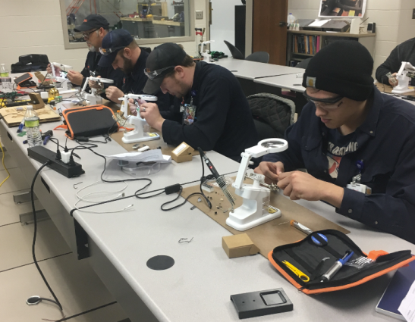
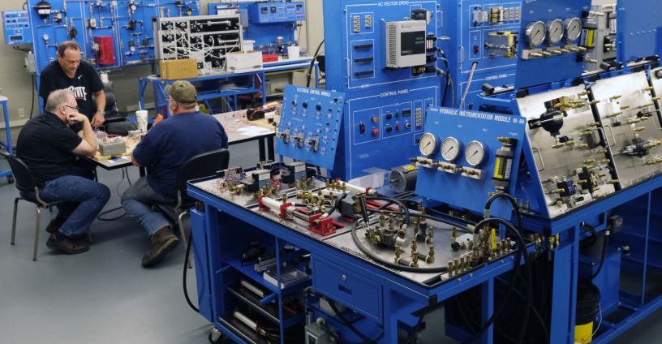
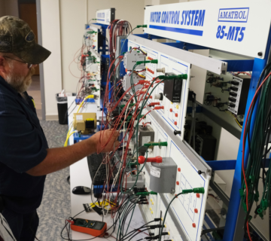
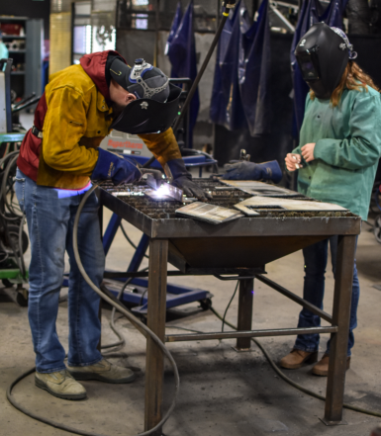
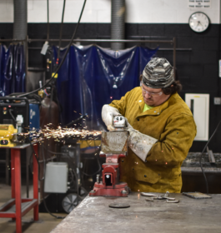
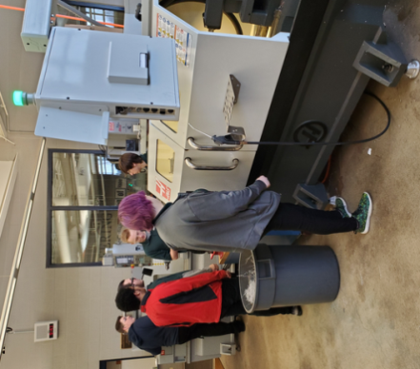
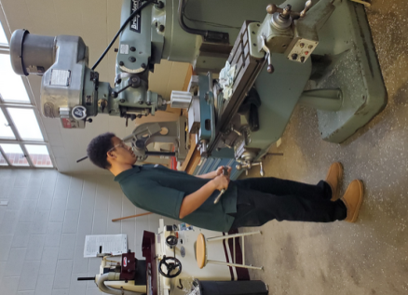
The Measure of Manufacturing Sector Partnerships Success
Tolles Career & Technical Center, Stanley Electric U.S. associates, Electrical Component Maintenance
Multi-craft Maintenance Training, Career & Technology Education Centers Licking County (C-TEC)
Pickaway – Ross Career & Technology Center, Adult Education, Welding
Eastland – Fairfield Career & Technical Schools, Pre-Engineering Students

Slide 23
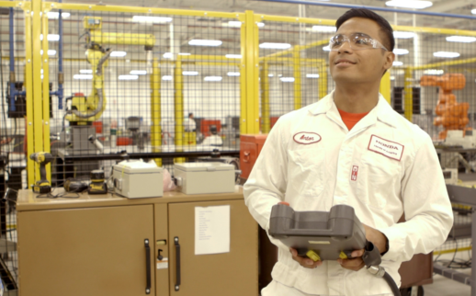
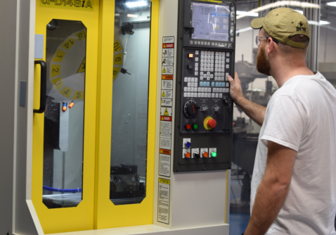
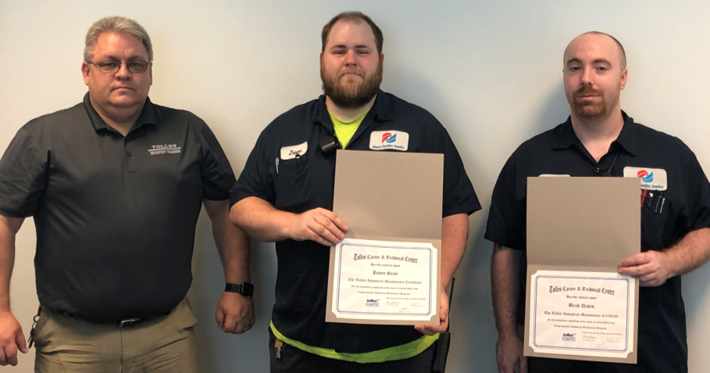
The Measure of Manufacturing Sector Partnerships Success
In its purest form, this is what the success of a manufacturing partnership really looks like:
Anton Dela Fuente, CSCC, Modern Mfg. Work-study, full-time Honda Equipment Services Associate
CNC Machining Training, Career & Technology Education Centers Licking County (C-TEC)
Nissen Chemitec America associates receiving their Industrial Maintenance Certificate from Troy Shampel of Tolles Career & Technical Center (Madison County)

Slide 24
Replicating success & COMP’s Path Forward

Slide 25
Replicating Success & COMP’s Path Forward
As COMP is still new our success to date has been to inform and link members to educational opportunities for their incumbent associates that they were not previously aware of. Through this interaction our members are developing relationships with the schools that they did not have prior.
In 2020 and 2021, COMP will be working with our members to take a more strategic approach to :
  Continue to grow our membership
  Educate manufacturing members of the educational resources currently available to them and assist them in taking advantage of the opportunities provided in the Scaled Apprenticeship Grant and TechCred
  Promote manufacturing education to K-12 and adult learners and be an active resource to support our educational members
  Identify any training gaps within the region and determine the feasibility and sustainability of developing new programs with our educational members

Slide 26

Questions?

Slide 27
Thank you!
If you are interested in learning more about COMP please contact Amber Gibbs at ambergibbscomp@gmail.com or
614.356.7871

